Slide 1

ANGULAR 4

Slide 2
Forms
A Simple Form and ngForm
Shutting Off Browser Form Validation
Checkboxes
Radio Buttons
Select and Options

Slide 3
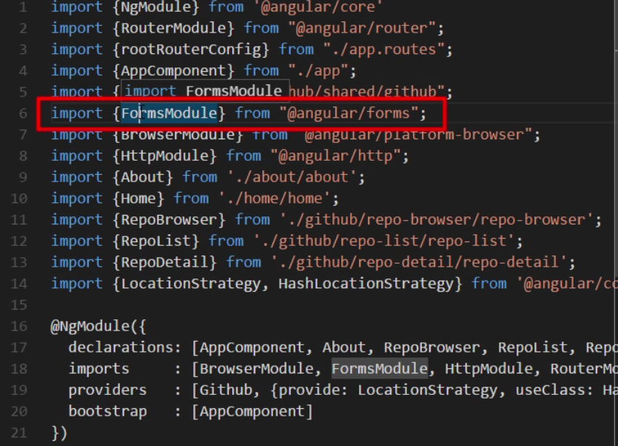
A SIMPLE FORM AND NGFORM
Import FormsModule is required.

Slide 4
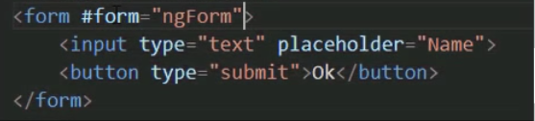

A SIMPLE FORM AND NGFORM
Template Reference Variable
Defining a “TRV” allows to access that object in the template.

Slide 5
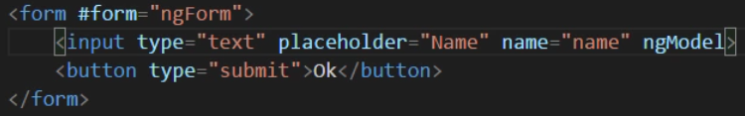
A SIMPLE FORM AND NGFORM
The name property is mandatory.

Slide 6
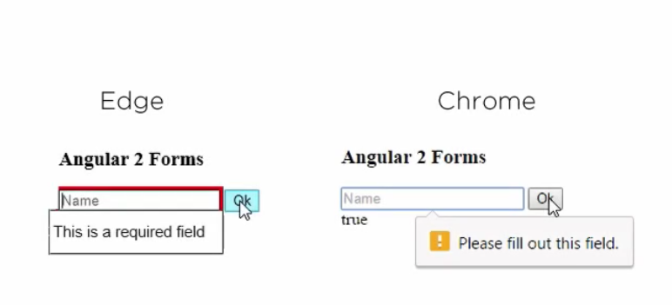
SHUTTING OFF BROWSER FORM VALIDATION
Browser form validation is handled by the browser. We get different experiences depending on the browser.

Slide 7
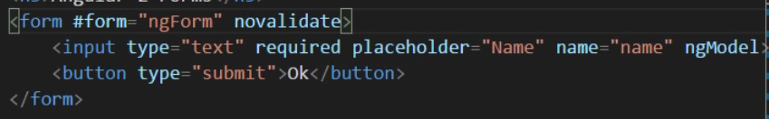
SHUTTING OFF BROWSER FORM VALIDATION
Turn Off the browser form validation.

Slide 8

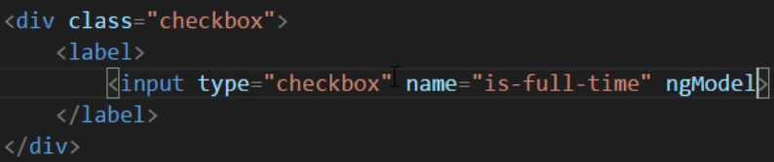
CHECKBOXES
form.componente.ts

Slide 9
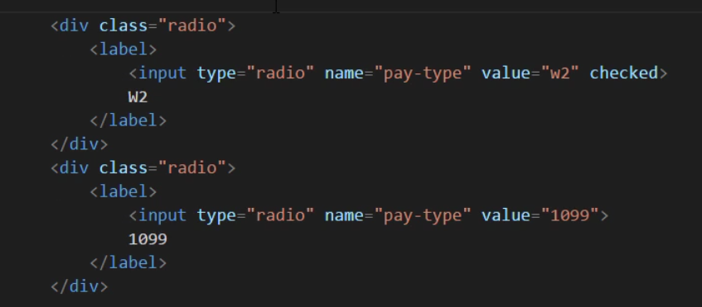

RADIO BUTTONS
form.componente.ts

Slide 10

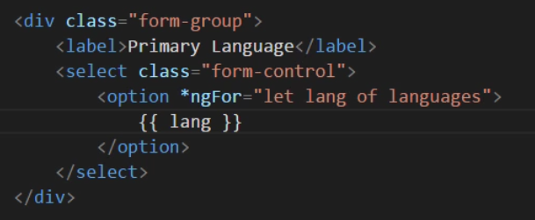
SELECT AND OPTIONS
form.componente.ts

Slide 11
DEMO
Build a form with inputs, checkboxs, radio buttons and selects.
Is a plus if you use the Materials framework.

